Slide 1
Recognizing Opportunities and Generating Ideas
Chapter 2

Slide 2


What is An Opportunity
An opportunity is a favorable
set of circumstances that
creates a need for a new
product, service or business.

Slide 3
Ideas vs. Opportunities
Not every business idea is a good business opportunity.
For example, you might have an idea for a neighborhood restaurant. But if that idea has no commercial potential, if it can’t make a profit, it isn’t an opportunity. If the public didn’t like the type of food you planned to serve, for example, the business would be doomed to fail.

Slide 4
Ideas vs. Opportunities
Ideas are a dime a dozen. Opportunities have value.
Ideas just take inspiration. Opportunities need perspiration too.
You can work on lots of ideas at once but should focus on only one or two opportunities.
When dealing with ideas it’s OK to dream, to speculate. When dealing with opportunities get ready to measure, to use data.
Investors do not put their money into ideas. They back opportunities.
Notes:
very common and of no particular value

Slide 5

Window of opportunity
For an entrepreneur to capitalize on an opportunity, its window of opportunity must be open.
The term “window of opportunity” is a metaphor describing the time period in which a firm can realistically enter a new market.
Once the market for a new product is established, its window of opportunity opens, and new entrants flow in.
At some point, the market matures, and the window of opportunity (for new entrants) closes.

Slide 6

Three Ways to Identify an Opportunity

Slide 7
First Approach: Observing Trends
Observing Trends
  Trends create opportunities for entrepreneurs to pursue.
  The most important trends are:
    Economic forces.
    Social forces.
    Technological advances.
    Political action and regulatory change.
  It’s important to be aware of changes in these areas.

Slide 8
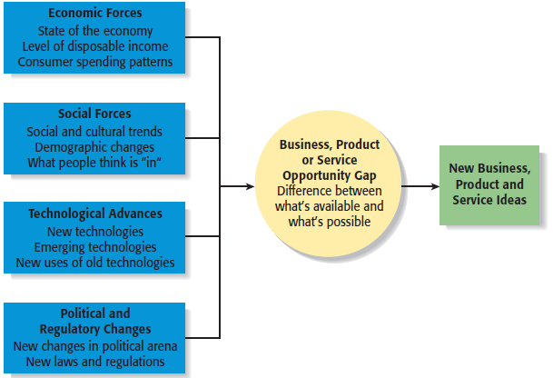
First Approach: Observing Trends
Environmental Trends Suggesting Business or Product Opportunity Gaps
Millennials (1980-2000)
Generation X (1960-1980)
Baby Boomers (1946-1964)

Slide 9
Second Approach: Solving a Problem
Solving a Problem
  Sometimes identifying opportunities simply involves noticing a problem and finding a way to solve it.
  These problems can be pinpointed through observing trends and through more simple means, such as intuition, serendipity, or change.
Notes:
the occurrence and development of events by chance in a happy or beneficial way.

Slide 10
Third Approach: Finding Gaps in the Marketplace
Gaps in the Marketplace
  A third approach to identifying opportunities is to find a gap in the marketplace
  A gap in the marketplace is often created when a product or service is needed by a specific group of people but doesn’t represent a large enough market to be of interest to mainstream retailers or manufacturers.

Slide 11
Personal Characteristics of the Entrepreneur
Characteristics that tend to make some people better at recognizing opportunities than others
Prior Experience
Cognitive Factors
Social Networks
Creativity

Slide 12
Prior Experience
Prior Industry Experience
  Several studies have shown that prior experience in an industry helps an entrepreneur recognize business opportunities.
    By working in an industry, an individual may spot a market niche that is underserved.
    It is also possible that by working in an industry, an individual builds a network of social contacts who provide insights that lead to recognizing new opportunities.

Slide 13
Cognitive Factors
Cognitive Factors
  Studies have shown that opportunity recognition may be an innate skill or cognitive process.
  Some people believe that entrepreneurs have a “sixth sense” that allows them to see opportunities that others miss.
  This “sixth sense” is called entrepreneurial alertness, which is formally defined as the ability to notice things without engaging in deliberate search.

Slide 14
Social Networks
Social Networks
  The extent and depth of an individual’s social network affects opportunity recognition.
  People who build a substantial network of social and professional contacts will be exposed to more opportunities and ideas than people with sparse networks.
  In one survey of 65 start-ups, half the founders reported that they got their business idea through social contacts.

Slide 15
Creativity
Creativity
  Creativity is the process of generating a novel or useful idea.
  Opportunity recognition may be, at least in part, a creative process.

Slide 16
Techniques For Generating Ideas
Brainstorming
Focus Groups
Library and
Internet Research
Lateral Marketing

Slide 17

Brainstorming
Brainstorming
  Is a technique used to generate a large number of ideas and solutions to problems quickly.
  A brainstorming “session” typically involves a group of people, and should be targeted to a specific topic.
  Rules for a brainstorming session:
    No criticism.
    Freewhelling is encouraged.
    The session should move quickly.

Slide 18
Focus Groups
Focus Group
  A focus group is a gathering of five to ten people, who have been selected based on their common characteristics relative to the issues being discussed.
  These groups are led by a trained moderator, who uses the internal dynamics of the group environment to gain insight into why people feel they way they do about a particular issue.
  Although focus groups are used for a variety of purposes, they can be used to help generate new business ideas.

Slide 19
Library and Internet Research
Library Research
  Libraries are an often underutilized source of information for generating new business ideas.
  The best approach is to talk to a reference librarian, who can point out useful resources, such as industry-specific magazines, trade journals, and industry reports.
  Simply browsing through several issues of a trade journal or an industry report on a topic can spark new ideas.

